Slide 1
Describing Objects and Classes

Slide 2

Interactive Quizzes
Notes:
Before you start today’s lessons, test your knowledge by answering some quiz questions that relate to yesterday’s lessons. Open your quiz file from labs > Quizzes > Java SE 8 Fundamentals Quiz.html. Click the links for Lessons 1, 2, 3, 4, and 5.
Java SE 8 Fundamentals 6 - <number>

Slide 3

Objectives
After completing this lesson, you should be able to:
  List the characteristics of an object
  Define an object as an instance of a class
  Instantiate an object and access its fields and methods
  Describe how objects are stored in memory
  Instantiate an array of objects
  Describe how an array of objects is stored in memory
  Declare and instantiate an object as a field
  Use the NetBeans IDE to create and test Java classes
Notes:
Java SE 8 Fundamentals 6 - <number>

Slide 4
Topics
  Describing objects and classes
  Defining fields and methods
  Declaring, instantiating, and using objects
  Working with object references
  Doing more with arrays
  Introducing NetBeans IDE
  Introducing the soccer league use case
Notes:
Java SE 8 Fundamentals 6 - <number>

Slide 5



Java Puzzle Ball
  Have you played Basic Puzzle 5?
  Consider the following:
    What happens when you put a triangle wall or simple wall icon on the blue wheel?
Notes:
Java SE 8 Fundamentals 6 - <number>

Slide 6


Java Puzzle Ball Debrief
What happens when you put a triangle wall or simple wall icon on a blue wheel?
  A wall appears on every instance of a blue bumper object.
  Walls give bumpers behaviors that deflect and interact with the ball.
  All blue bumper instances share these same behaviors.
instance
instance
Notes:
A blue bumper is an object, and every instance of these objects will share the same behavior for interacting with the ball. These behaviors may include deflection via triangle or the simple wall.
Java SE 8 Fundamentals 6 - <number>

Slide 7
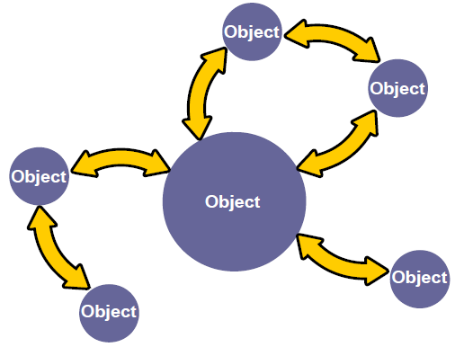
Object-Oriented Programming
  Interaction of objects
  No prescribed sequence
Notes:
You have seen this diagram before in the “What Is a Java Program?” lesson. The diagram illustrates how object-oriented programming stresses the interaction of objects. The current lesson teaches you how to identify the objects that are required for the application that you would like to build. You first identify what the objects are, you determine the object’s characteristics or properties, and then you determine the object’s behaviors or operations. You then translate that analysis into Java code to create your application. It is time to learn more about objects.
Java SE 8 Fundamentals 6 - <number>

Slide 8







Duke’s Choice Order Process
Notes:
In the first five lessons, the exercises mention a shopping cart class that contains items. Take another look at the shopping cart scenario.
Imagine an online store called Duke’s Choice. His number one shopper is his mother, Mrs. Duke. As Mrs. Duke shops, she places items in a shopping cart. Mrs. Duke likes shirts, so she places shirts in her cart. After she fills the cart, she checks out. The checkout process applies the purchase to a credit card, which is verified, and then Mrs. Duke receives an order number so that she can track her order or return it.
As a software developer, when you are presented with a scenario such as Duke’s Choice for an application that you need to develop, you can analyze the scenario by breaking it into steps and defining the objects of the scenario.
Java SE 8 Fundamentals 6 - <number>

Slide 9


Characteristics of Objects
Objects are physical or conceptual.
  Objects have properties:
    Size
    Shape
    Name
    Color
  Objects have behaviors:
    Shop
    Put item in cart
    Pay
Mrs. Duke
Color property value is red
Notes:
To validate objects in a problem domain, such as the Duke’s Choice order process, you identify the properties of all objects:
Objects can be physical or conceptual. A customer’s credit card account is an example of a conceptual object, because it is not something you can physically touch. A shirt is an example of a physical object.
Objects have properties (attributes) such as size, name, and shape that represent the state of the object. For example, a person has a name (Mrs. Duke), and an object might have a color property. The value of all of an object’s properties is often referred to as the object’s current state. An object might have a color property with the value of red and a size property with a value of large.
Objects also have behaviors (things they can do) such as, in our example, shop, put an item in the cart, and purchase.
Java SE 8 Fundamentals 6 - <number>

Slide 10



Classes and Instances
  A class:
    Is a blueprint or recipe for an object
    Describes an object’s properties and behaviors
    Is used to create object instances
Object instances
Class
-Properties
-Behaviors
Notes:
You just learned about some of the objects, characteristics, and behaviors in the Duke’s Choice scenario. Here is an example of one of Duke’s Choice objects, the Customer, and its function in the store. Customer is the class, and a class is a blueprint or recipe for an object. The class describes an object’s properties and behaviors.
Classes are used to create object instances, such as the three Customer object instances, as illustrated by the three images.
Java SE 8 Fundamentals 6 - <number>

Slide 11

Quiz
Which of the following statements is true?
  An object is a blueprint for a class.
  An object and a class are exactly the same.
  An object is an instance of a class.
  A class is an instance of an object.
Notes:
Answer: c
a is false because a class is a blueprint for an object.
b is false because an object is an instantiation of a class, and a class
serves as a blueprint for the object.
c is correct.
d is false because an object is an instance of a class.
Java SE 8 Fundamentals 6 - <number>

Slide 12
Topics
  Describing objects and classes
  Defining fields and methods
  Declaring, instantiating, and using objects
  Working with object references
  Doing more with arrays
  Introducing NetBeans IDE
  Introducing the soccer league use case
Notes:
You have just learned about objects, classes, and their characteristics (properties and behaviors). Now it is time to look at fields and methods.
Java SE 8 Fundamentals 6 - <number>

Slide 13
The Customer Properties and Behaviors
Behaviors:
  Shop
  Set Address
  Add item to cart
  Ask for a discount
  Display customer details
Properties:
  Name
  Address
  Age
  Order number
  Customer number
Notes:
Think of some properties and behaviors that are in the Customer class of Duke’s Choice. Think about how you would write this information as a Java class.
Java SE 8 Fundamentals 6 - <number>

Slide 14
The Components of a Class
Class declaration
1 public class Customer {
2 public String name = "Junior Duke";
3 public int custID = 1205;
4 public String address;
5 public int orderNum;
6 public int age;
7
8 public void displayCustomer(){
9 System.out.println("Customer: "+name);
}
11 }
Fields
(Properties)
(Attributes)
Methods
(Behaviors)
Notes:
In the previous slide, you have identified some properties and behaviors that might be in the Customer class. This code example demonstrates how the properties and methods are created in Java. The basic components of a Java class are:
The class declaration. Notice that the entire class is surrounded by braces.
Fields of the class. These represent the properties or attributes of the class.
Methods of the class. These represent the behaviors or operations. Here you see just one method, displayCustomer.
Note: In the code example above, the word “public” is a modifier, and you learn about modifiers later in the course.
Java SE 8 Fundamentals 6 - <number>

Slide 15
Modeling Properties and Behaviors
Customer class
name
address
billing info
age
customer number
order number
requestDiscount()
setAddress()
shop()
displayCustomer()
Class name
Fields
Methods
Notes:
As you design an application, it is often helpful to create a simple model that describes the components of a class. In the table above, the class name is listed at the top. The properties or fields are listed in the second row, and the behaviors, or methods, are listed in the third row. If you compare this modeling in terms of language, you can think of the class as a noun, the properties or fields as adjectives, and the behaviors or methods as verbs.
Java SE 8 Fundamentals 6 - <number>

Slide 16
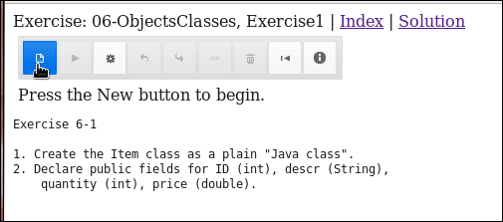

Exercise 6-1: Creating the Item Class
In this exercise, you create the Item class and declare public fields for ID (int), descr, quantity (int), and price (double).
Notes:
In the Java Code Console, access Lessons > 06-Objects > Exercise1.
Follow the instructions below the code editor to create the Item class and declare public fields for ID (int), descr, quantity (int), and price (double). You will not be able to test the Item class until Exercise 6-2.
If you need help, click the Solution link. To go back to your code, click the Exercise link again. Any changes that you have made will have been saved.
Java SE 8 Fundamentals 6 - <number>

Slide 17
Topics
  Describing objects and classes
  Defining fields and methods
  Declaring, instantiating, and using objects
  Working with object references
  Doing more with arrays
  Introducing NetBeans IDE
  Introducing the soccer league use case
Notes:
Java SE 8 Fundamentals 6 - <number>

Slide 18
Customer Instances
customer01
customer02
public static void main(String[] args){
Customer customer01 = new Customer();
Customer customer02 = new Customer();
customer01.age = 40;
customer02.name = "Duke";
customer01.displayCustomer();
customer02.displayCustomer();
}
}
Create new instances (instantiate).
Fields are accessed.
Methods are called.
Notes:
In the code example, two new instances of the Customer object called customer01 and customer02 are created. (Another term for created is “instantiated.”) After the objects are instantiated, the reference variables customer01 and customer02 can be used to access fields and methods of the objects. The next two slides explain variations on instantiation, and the dot operator. There is more information on methods in the lesson titled “Creating and Using Methods.”
Java SE 8 Fundamentals 6 - <number>

Slide 19
Object Instances and Instantiation Syntax
variable becomes a reference to that object.
The new keyword creates (instantiates) a new instance.
The syntax is:
<class name> variable = new <class name>()
public static void main(String[] args){
Customer customer01 = new Customer(); //Declare and instantiate
Customer customer02; //Declare the reference
customer02 = new Customer(); //Then instantiate
new Customer(); //Instantiation without a reference
//We can’t use this object later
//without knowing how to reference it.
}
}
Notes:
By using the new keyword, a new instance of the class is now available to be accessed through the variable, which stores a reference to that object. It can be referred to as a reference variable or an object reference.
Notice that, following the new keyword, you see the class name followed by parentheses. This looks similar to calling a method, doesn’t it? You are calling a method—the constructor method of the Customer class. Every class has a constructor method that has the same name as the class. Constructors are covered in more detail in the lesson titled “Creating and Using Methods.”
To summarize, there are three steps to getting an object reference:
1. Declare the reference.
2. Instantiate the object using the new keyword and the class constructor method.
3. Assign the object to the reference.
Note that the way that the assignment operator (an = symbol) works requires that the reference and the newly created object must be in the same statement. (Statements are ended with the semicolon symbol and are not the same as lines. The end of a line means nothing to the Java compiler; it only helps make the code more readable.)
Java SE 8 Fundamentals 6 - <number>

Slide 20
The Dot (.) Operator
Follow the reference variable with a dot operator (.) to access the fields and methods of an object.
public static void main(String[] args){
Customer customer01 = new Customer();
//Accessing fields
System.out.println(customer01.name);
customer01.age = 40;
//Calling methods
customer01.requestDiscount();
customer01.displayCustomer();
}
}
Customer class
name
address
billing info
age
customer number
order number
requestDiscount()
setAddress()
shop()
displayCustomer()
Notes:
Java SE 8 Fundamentals 6 - <number>

Slide 21
Objects with Another Object as a Property
Customer class
customer number
*cart
name
address
billing info
order number
requestDiscount()
setAddress()
shop()
displayCustomer()
Cart class
Item[]
date
total
addItem()
checkOut()
cancel()
public static void main(String[] args){
Customer customer01 = new Customer();
customer01.cart.cancel(); //How to access methods of an
//object within another object
}
Notes:
So far you have seen objects with properties such as boolean, int, double, and String. What if you wanted an object’s property to be another object with its own set of properties and behaviors, such as a costumer with a cart property? That way, an instance of a Customer would have access to the properties and behaviors found in a Cart. This would enable the customer to add items to the cart and then checkOut (purchase) the cart. Can this be done? The answer is yes.
You can access fields and methods of objects within another object by applying the dot operator multiple times.
Note: A best practice is to use attribute and operation names that clearly describe the attribute or operation. The asterisk (*) denotes an attribute that is a reference to another object.
Java SE 8 Fundamentals 6 - <number>

Slide 22
Quiz
Which of the following lines of code instantiates a Boat object and assigns it to a sailBoat object reference?
  Boat sailBoat = new Boat();
  Boat sailBoat;
  Boat = new Boat()
  Boat sailBoat = Boat();
Notes:
Answer: a
Java SE 8 Fundamentals 6 - <number>

Slide 23
Topics
  Describing objects and classes
  Defining fields and methods
  Declaring, instantiating, and using objects
  Working with object references
  Doing more with arrays
  Introducing NetBeans IDE
  Introducing the soccer league use case
Notes:
Java SE 8 Fundamentals 6 - <number>

Slide 24


Accessing Objects by Using a Reference
The camera is like the object that is accessed using a reference.
The remote is like the reference
used to access the camera.
Notes:
What you have learned up to this point is:
Objects are accessed using references.
Objects are instantiated objects of their class type.
Objects consist of properties and operations, which in Java are fields and methods.
To work with an object, you need to access it using a reference. A good analogy is using a remote control to operate an electronic device. The buttons on the remote control can be used to modify the behavior of the device (in this case, a camera). For example, you can make the camera stop, play, or record by interacting with the remote.
Java SE 8 Fundamentals 6 - <number>

Slide 25
Working with Object References
1
1
Pick up the remote to gain access to the camera.
Create a Camera object and get a reference to it.
11 Camera remote1;
12
13 remote1 = new Camera();
14
15 remove1.play();
2
2
Press the remote’s controls to have camera do something.
Call a method to have the Camera object do something.
Notes:
Consider the analogy of using a remote control to operate an electronic device. To operate an electronic device with a remote, you need to:
1. Pick up the remote (and possibly turn it on)
2. Press a button on the remote to do something on the camera
Similarly, to do something with a Java object, you need to:
1. Get its “remote” (called a reference)
2. Press its “buttons” (called methods)
Java SE 8 Fundamentals 6 - <number>

Slide 26
Working with Object References
remote1
remote2
12 Camera remote1 = new Camera();
13
14 Camera remote2 = new Camera();
15
16 remote1.play();
17
18 remote2.play();
There are two
Camera objects.
Notes:
There are two camera objects in this example. Each camera has its own unique remote. remote2 will not work on remote1’s camera, and remote1 will not work on remote2’s camera. This reflects how in Java, two different objects can be instantiated with their own unique references. These references can be used to call methods on their respective objects.
Java SE 8 Fundamentals 6 - <number>

Slide 27
Working with Object References
There is only one
Camera object.
remote2
12 Camera remote1 = new Camera();
13
14 Camera remote2 = remote1;
15
16 remote1.play();
17
18 remote2.stop();
remote1
Notes:
The diagram shows another important aspect of how references work. In this example, a Camera object is created and its reference assigned to a Camera reference, remote1. This reference is then assigned to another Camera reference, remote2. Now both references are associated with the same Camera object, and methods called on either reference will affect the same Camera object. Calling remote1.play is no different than calling remote2.play. Both remotes operate the same camera.
Java SE 8 Fundamentals 6 - <number>

Slide 28








References to Different Objects
Television
Camcorder
Television
remote
Camcorder
remote
Notes:
To extend the analogy just a little further, to work with a different type of object (for example, a television), you need a remote for that object. In the Java world, you need a reference of the correct type for the object that you are referencing.
You can ignore the fact that there is such a thing as a universal remote controller, although later in the course you will discover that Java also has the concept of references that are not limited to a single object type! For the moment, let’s just say that a reference of the same type as the object is one of the reference types that can be used, and is a good place to start exploring the world of Java objects.
Java SE 8 Fundamentals 6 - <number>

Slide 29
References to Different Objects
Reference type
Reference variable
Create a new object.
6 Camera remote1 = new Camera();
7 remote1.menu();
8
9 TV remote2 = new TV();
10 remote2.menu();
11
12 Shirt myShirt = new Shirt();
13 myShirt.display();
14
15 Trousers myTrousers = new Trousers();
16 myTrousers.display();
Notes:
remote1 references a Camera object.
remote2 references a TV object.
myShirt references a Shirt object.
myTrousers references a Trousers object.
Java SE 8 Fundamentals 6 - <number>

Slide 30
References and Objects in Memory
12 int counter = 10;
13 Shirt myShirt = new Shirt();
14 Shirt yourShirt = new Shirt();
Stack
0x034009
Heap
12
shirtID
15.99
price
B
colorCode
counter
10
0x99f311
myShirt
0x034009
12
shirtID
15.99
price
yourShirt
0x99f311
B
colorCode
Variables
Objects
Notes:
This diagram shows how references point to a particular object in memory. Note that there are two objects in memory, although they are both of type Shirt. Also note that there are two Shirt references pointing to these two Shirt objects.
The diagram also shows two types of memory that Java uses: the stack and the heap. The stack holds local variables, either primitives or reference types, whereas the heap holds objects. Later in this course, you will learn a little more about local variables, but for now it is sufficient to know that local variables are not fields of an object.
Java SE 8 Fundamentals 6 - <number>

Slide 31
Assigning a Reference to Another Reference
myShirt = yourShirt;
0x034009
12
15.99
B
counter
10
0x99f311
myShirt
0x99f311
12
shirtID
15.99
price
yourShirt
0x99f311
B
colorCode
Notes:
The diagram shows what happens if the myShirt reference, after having its own object (in the previous slide), is now assigned the reference yourShirt. When this happens, the myShirt reference will drop its current object and be reassigned to the same object that yourShirt has. As a result, two references, myShirt and yourShirt, now point to the same object. Any changes to the object made by using one reference can be accessed using the other reference, and vice versa.
Another effect of assigning the reference yourShirt to the reference myShirt is that if the previous object referred to by myShirt has no other references, it will now be inaccessible. In due course, it will be garbage collected, meaning that its memory will become available to store other objects.
Java SE 8 Fundamentals 6 - <number>

Slide 32
Two References, One Object
Code fragment:
12 Shirt myShirt = new Shirt();
13 Shirt yourShirt = new Shirt();
14
15 myShirt = yourShirt; //The old myShirt object is
16 //no longer referenced
17 myShirt.colorCode = 'R';
18 yourShirt.colorCode = 'G';
19
20 System.out.println("Shirt color: “ + myShirt.colorCode);
Output from code fragment:
Shirt color: G
Notes:
This example now shows what happens if you use either reference to make a change or get a value from the object. References yourShirt and myShirt refer to the same object, so making a change or getting a field value by using one reference is exactly the same as doing it with the other reference. The old object that was previously referenced by myShirt goes away.
Java SE 8 Fundamentals 6 - <number>

Slide 33
Exercise 6-2: Modify the ShoppingCart to Use Item Fields
  In this exercise, you:
    Declare and instantiate two variables of type Item in the ShoppingCart class
    Experiment with accessing properties and calling methods on the object
Notes:
In the Java Code Console, access Lessons > 06-ObjectsClasses > Exercise2.
Follow the instructions below the code editor to:
Declare and instantiate two variables of type Item.
Initialize only the desc field.
Use different values for each object.
Display the description of each object.
If you need help, click the Solution link. To go back to your code, click the Exercise link again. Any changes that you have made will have been saved.
Java SE 8 Fundamentals 6 - <number>

Slide 34
Topics
  Describing objects and classes
  Defining fields and methods
  Declaring, instantiating, and using objects
  Working with object references
  Doing more with arrays
  Introducing NetBeans IDE
  Introducing the soccer league use case
Notes:
Java SE 8 Fundamentals 6 - <number>

Slide 35
Arrays Are Objects
Arrays are handled by an implicit Array object.
  The Array variable is an object reference, not a primitive data type.
  It must be instantiated, just like other objects.
    Example:
      int[] ages = new int[4];
  Previously, you have been using a shortcut to instantiate your arrays.
    Example:
      int[] ages = {8,7,4,5};
This array can hold four elements.
Notes:
An array is actually an object type and is handled implicitly through a class called Array (not available in the Java API documentation). Therefore, like other object types (String is an exception) it must be instantiated using the new keyword.
In the top example, an int array called ages is declared and instantiated with a capacity to hold four elements.
Java SE 8 Fundamentals 6 - <number>

Slide 36
Declaring, Instantiating, and Initializing
Arrays
All in one line
  Examples:
1 String[] names = {"Mary","Bob","Carlos"};
2
3 int[] ages = new int[3];
4 ages[0] = 19;
5 ages[1] = 42;
6 ages[2] = 92;
  Not permitted (compiler will show an error):
Multistep approach
  int [] ages;
  ages = {19, 42, 92};
Notes:
As introduced in the lesson titled “Managing Multiple Items,” there are two approaches for creating and initializing arrays. Using the new keyword allows you to declare and instantiate an array of a particular size and initialize it at a later time.
Java SE 8 Fundamentals 6 - <number>

Slide 37
Storing Arrays in Memory
int age = 35;
int[] ages = {19, 42, 92};
Primitive variable of type int
0x034009
age
35
0
19
Primitive variables of type int held as array elements
ages
0x034009
1
42
2
92
Notes:
Arrays are objects referred to by an object reference variable. The diagram in the slide illustrates how a primitive array is stored in memory in comparison to how a primitive data type is stored in memory.
The value of the age variable (an int primitive) is 35. The value of ages is 0x034009, an object reference pointing to an object of type array (of int types) with three elements.
The value of ages[0] is 19.
The value of ages[1] is 42.
The value of ages[2] is 92.
Java SE 8 Fundamentals 6 - <number>

Slide 38
Storing Arrays of Object References in Memory
Item item = new Item();
Item[] items = { new Item(), new Item(), new Item() };
0
0.0
U
itemId
item
0x034009
price
colorCode
items
0x99f311
0
0.0
U
itemId
0x99f311
price
0x00099
0x00327
0x00990
colorCode
0
0.0
U
itemId
price
colorCode
0
0.0
U
itemId
price
colorCode
Notes:
The diagram in the slide illustrates how an object reference array is stored in memory. The value of the item object reference is x034009, which is an address to an object of type Item with the values 0, 0.0, and U.
The value of the items[ ] object reference is x99f311, which is an address to an object of type Array (of Item object references) containing three object references:
The value of the items[0] index is 0x00099, which is an object reference pointing to an object of type Item.
The value of the items[1] index is 0x00327, which is an object reference pointing to another object of type Item.
The value of the items[2] index is 0x00990, which is an object reference pointing to another object of type Item.
Java SE 8 Fundamentals 6 - <number>

Slide 39
Quiz
The following code is the correct syntax for _____ an array:
array_identifier = new type[length];
  Declaring
  Setting array values for
  Instantiating
  Declaring, instantiating, and setting array values for
Notes:
Answer: c
a is incorrect. Declaring the array would look like this, assuming an array of object types: Type[] array_identifier;
b is incorrect. Setting array values would look like this, assuming an array of object types:
array_identifier[0]= new Type();
c is correct. The code example shows the array being initialized to a specific size.
d is incorrect. Declaring, instantiating, and setting array values would look like this, assuming an array of object types:
Type[] array_identifier = {new Type(), new Type(), new Type()};
Java SE 8 Fundamentals 6 - <number>

Slide 40
Quiz
Given the following array declaration, which of the following statements are true?
    int [ ] ages = new int [13];
  ages[0] is the reference to the first element in the array.
  ages[13] is the reference to the last element in the array.
  There are 13 integers in the ages array.
  ages[5] has a value of 0.
Notes:
Answer: a, c, d
Java SE 8 Fundamentals 6 - <number>

Slide 41
Topics
  Describing objects and classes
  Defining fields and methods
  Declaring, instantiating, and using objects
  Working with object references
  Doing more with arrays
  Introducing NetBeans IDE
  Introducing the soccer league use case
Notes:
Java SE 8 Fundamentals 6 - <number>

Slide 42
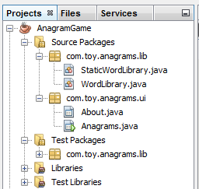
Java IDEs
A Java Integrated Development Environment (IDE) is a type of software that makes it easier to develop Java applications.
  An IDE provides:
    Syntax checking
    Various automation features
    Runtime environment for testing
  It enables you to organize all your Java resources and environment settings into a Project.
Notes:
Some well-known Java IDEs are NetBeans (used in this class to perform the practices), Eclipse, and JDeveloper.
Java SE 8 Fundamentals 6 - <number>

Slide 43
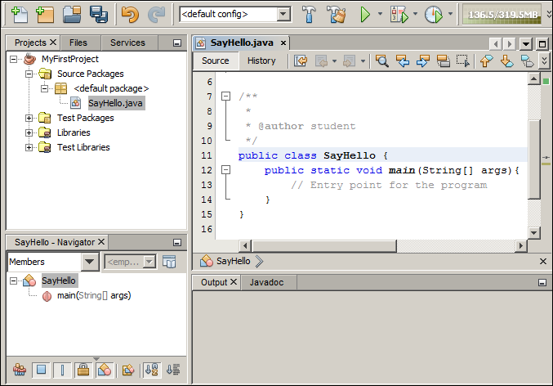
The NetBeans IDE
Code Editor
Project
Navigator
Class Navigator
Program Output
Notes:
The Java project provides a mechanism by which you can organize all of the source and class files and other resources (connection profiles, configuration information, and so on) required by the Java application.
When you begin working in NetBeans, you either create a project or open an existing one.
The Project Navigator gives you a visual representation of the project contents.
You can open files from your project in the code editor by double-clicking the file or using the context menu.
When you select a class within the project, the structure of that class is displayed in the Class Navigator, shown in the lower left part of the NetBeans window.
When you run a file or the entire Java program, any program output appears in the Output panel in the lower right part of the window.
Java SE 8 Fundamentals 6 - <number>

Slide 44
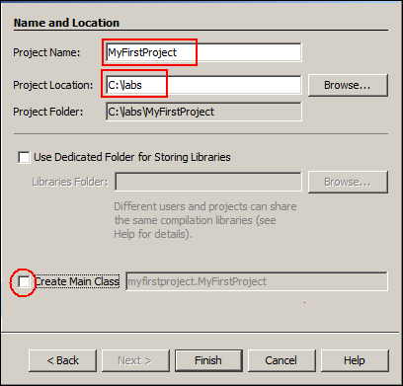
Creating a Java Project
  Select File > New Project.
  Select Java Application.
  Name and set the location
  for the project.
  Select “Create Main Class”
  if you want it done for you
  automatically.
  Click Finish.
Notes:
A NetBeans project is a mechanism for organizing the related files and resources used in a Java Application. To create a new project, perform the following steps:
1. Select File > New Project from the menu.
2. On the first page of the New Project Wizard (not shown here), select Java as the category and Java Application as the project type. Click Next.
3. On the second page of the wizard (shown above), enter a name for the project, and then enter or browse to the directory location to store project files.
4. It is possible to have NetBeans automatically generate a main class for the project.
5. Click Finish.
Java SE 8 Fundamentals 6 - <number>

Slide 45
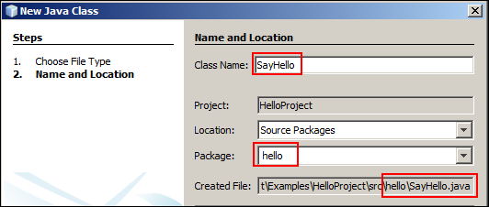
Creating a Java Class
  Select File > New File.
  Select your project and choose Java Class.
  Name the class.
  Assign a package.
  Click Finish.
Notes:
To create a class within your new project, perform the following steps:
1. Select File > New File from the menu.
2. On the first page of the New File Wizard, select your project, and then accept the default file type of Java Class. Click Next.
3. On the next page of the wizard, enter a name for the Java class. By convention, Java classes should start with an uppercase letter and each subsequent word in the class name should be capitalized (for example, SayHello). This is illustrated in the screenshot above.
4. Assign a package for the class.
5. Click Finish.
Note: If the package for this new class already exists, you can create the class by right-clicking the package in the Project Navigator panel in NetBeans and selecting New > Java class from the context menu instead of starting from the File menu.
Java SE 8 Fundamentals 6 - <number>

Slide 46
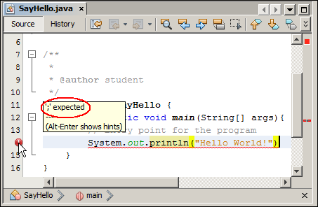
Avoiding Syntax Problems
The code editor will tell you when you have done something wrong.
Notes:
Most Java editors check the code syntax and show alerts by using icons and red underlines where there are errors in the code.
To avoid syntax problems, be sure to do the following:
Observe any red bubble indicators in the code editor to locate syntax errors.
Have a semicolon at the end of every line where one is required.
Have an even number of symbols such as braces, brackets, and quotation marks.
The screenshot shows an error in Line 13, in which there is a missing semicolon. If you place your cursor over the red bubble, the editor offers a suggestion for fixing the error.
Java SE 8 Fundamentals 6 - <number>

Slide 47
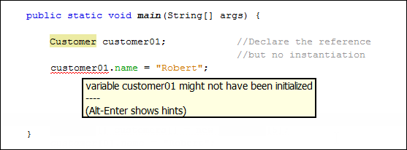
Compile Error: Variable Not Initialized
1 public static void main(String[] args){
2
3 Customer customer01; //Declare the reference
4 //No instantiation
5 customer01.name = "Robert";
9
10 }
NetBeans indicates that the variable may not have been initialized.
Notes:
If you try to use a reference that has been declared but has had no object assigned to it, the class will not compile. This is because there is no Customer object assigned to the customer01 reference. NetBeans will flag this, and indicate that “the variable may not have been initialized.”
Java SE 8 Fundamentals 6 - <number>

Slide 48

Runtime Error: NullPointerException
1 public static void main(String[] args){
2
3 Customer customer01; //Declare the reference
4 customer01 = new Customer(); //Instantiate and assign
5 customer01.name = "Robert";
6
7 Customer[] customers = new Customer[5];
8 customers[0].name = "Robert";
9
10 }
NetBeans output window indicates a NullPointerException.
This reference has not been assigned.
Notes:
If an array has been created but the individual elements have had no objects assigned, the class will compile, but you will get a runtime error. The error is a NullPointerException. Later in the lesson titled “Handling Exceptions,” you will learn exactly what this means; for now it is just important to recognize that a NullPointerException indicates that a reference has no object assigned; that it is null.
Java SE 8 Fundamentals 6 - <number>

Slide 49
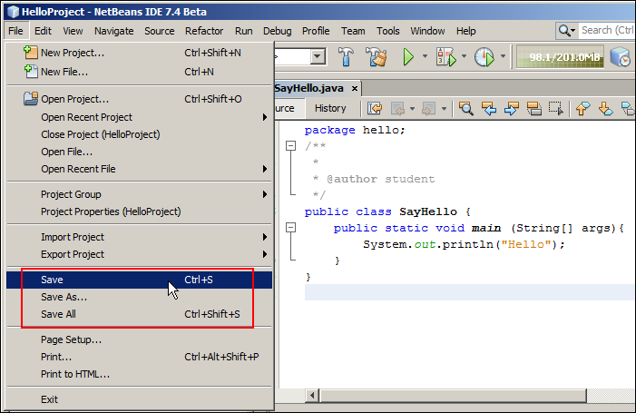
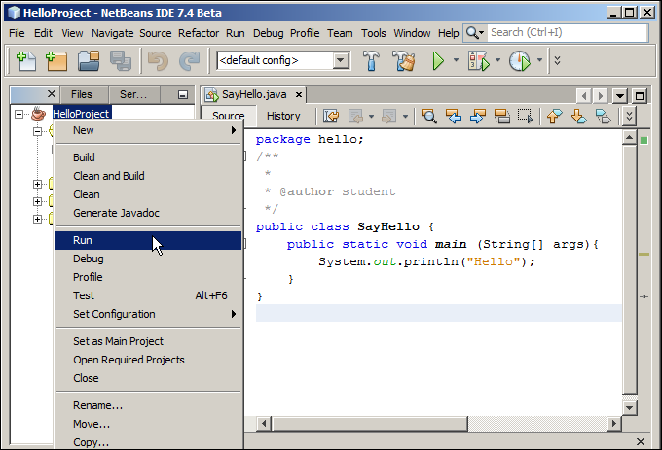
Compiling and Running a Program by
Using NetBeans
Save is equivalent to javac.
Run is equivalent
to java.
Notes:
Save invokes the javac <classname(s)> command for all .java files in the project. Right-clicking the source code and selecting Run File invokes the java <classname> command. Be sure to look for red bubble indicators in the code editor to locate syntax errors.
Java SE 8 Fundamentals 6 - <number>

Slide 50
Topics
  Describing objects and classes
  Defining fields and methods
  Declaring, instantiating, and using objects
  Working with object references
  Doing more with arrays
  Introducing NetBeans IDE
  Introducing the soccer league use case
Notes:
Java SE 8 Fundamentals 6 - <number>

Slide 51
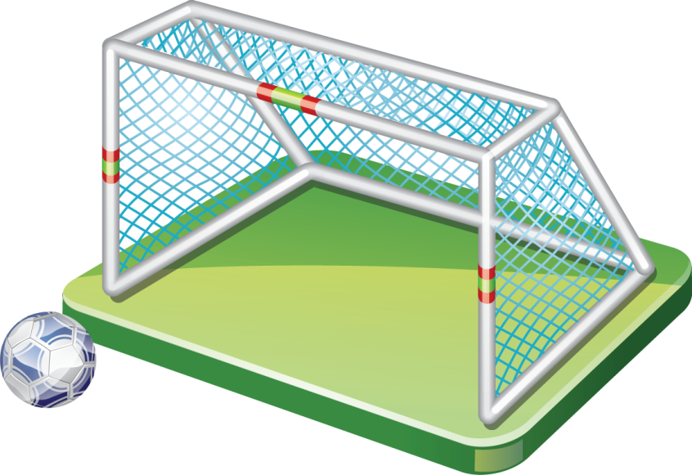
Soccer Application
Practices 6 through 14 build a soccer league application with the following features:
  Any number of soccer teams, each with up to 11 players
  Set up an all-play-all league.
  Use a random play game generator to create test games.
  Determine the rank order of teams at the end of the season.
Notes:
In the remaining practices in this course, you will build an application that manages a Soccer League. The application will keep details on teams and players, as well as the results of games.
You will also write code that will randomly generate game results so that you can then develop code to list the Teams in rank order.
Java SE 8 Fundamentals 6 - <number>

Slide 52
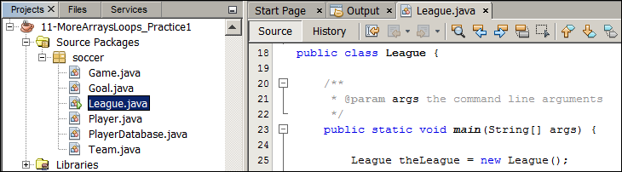
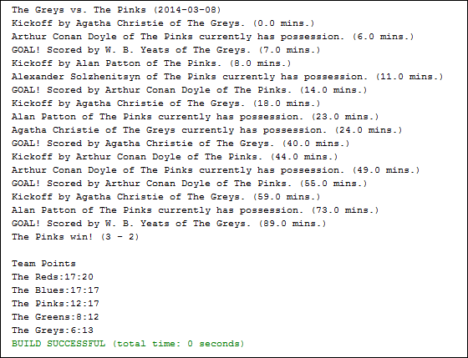
Creating the Soccer Application
A separate project for each practice
Sample output showing events in a game
Sample output showing rank order of teams
Notes:
Initially, your application will be developed in NetBeans and you will see the results of running your code as text in the output window.
Java SE 8 Fundamentals 6 - <number>

Slide 53
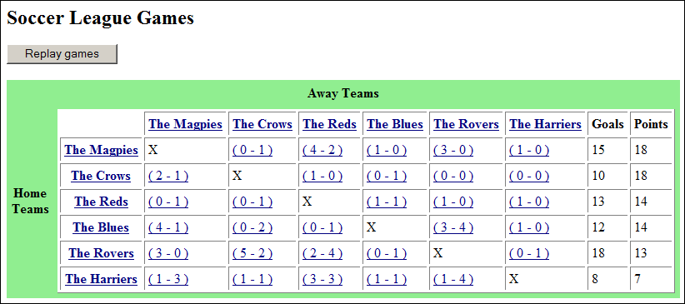
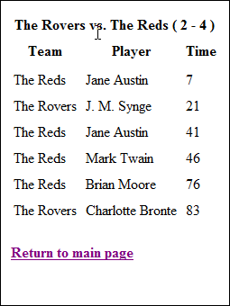
Soccer Web Application
Points and goals scored used for ordering
Click the score of a game to show game details.
Teams listed in rank order
Notes:
The code that you write in the practices can be used by a simple web application to view the results of games in the league. You will see a demonstration of this.
Java SE 8 Fundamentals 6 - <number>

Slide 54

Summary
In this lesson, you should have learned how to:
  Describe the characteristics of a class
  Define an object as an instance of a class
  Instantiate an object and access its fields and methods
  Describe how objects are stored in memory
  Instantiate an array of objects
  Describe how an array of objects is stored in memory
  Declare an object as a field
  Use the NetBeans IDE
Notes:
Java SE 8 Fundamentals 6 - <number>

Slide 55
Challenge Questions: Java Puzzle Ball
  How many objects can you identify in the game?
  Given that a class is a blueprint for an object, which game components best reflect the class/instance relationship?
  How many object properties can you find?
  Can you guess what some of the methods might be?
Notes:
When you have an opportunity to play the game, see if you can answer these questions, applying the object-oriented concepts that you learned in this lesson.
For some possible answers to these questions and more discussion, see “Appendix A: Java Puzzle Ball Challenge Questions Answered.”
Java SE 8 Fundamentals 6 - <number>

Slide 56

Practice 6-1 Overview:
Creating Classes for the Soccer League
This practice covers creating the five classes required for the soccer application:
  Goal
  Game
  Player
  Team
  League
Notes:
Java SE 8 Fundamentals 6 - <number>

Slide 57
Practice 6-2 Overview:
Creating a Soccer Game
This practice covers the following topics:
  Creating a new game
  Adding some goals
Notes:
Java SE 8 Fundamentals 6 - <number>

